Slide 1



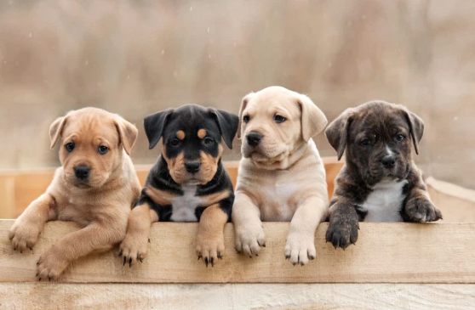
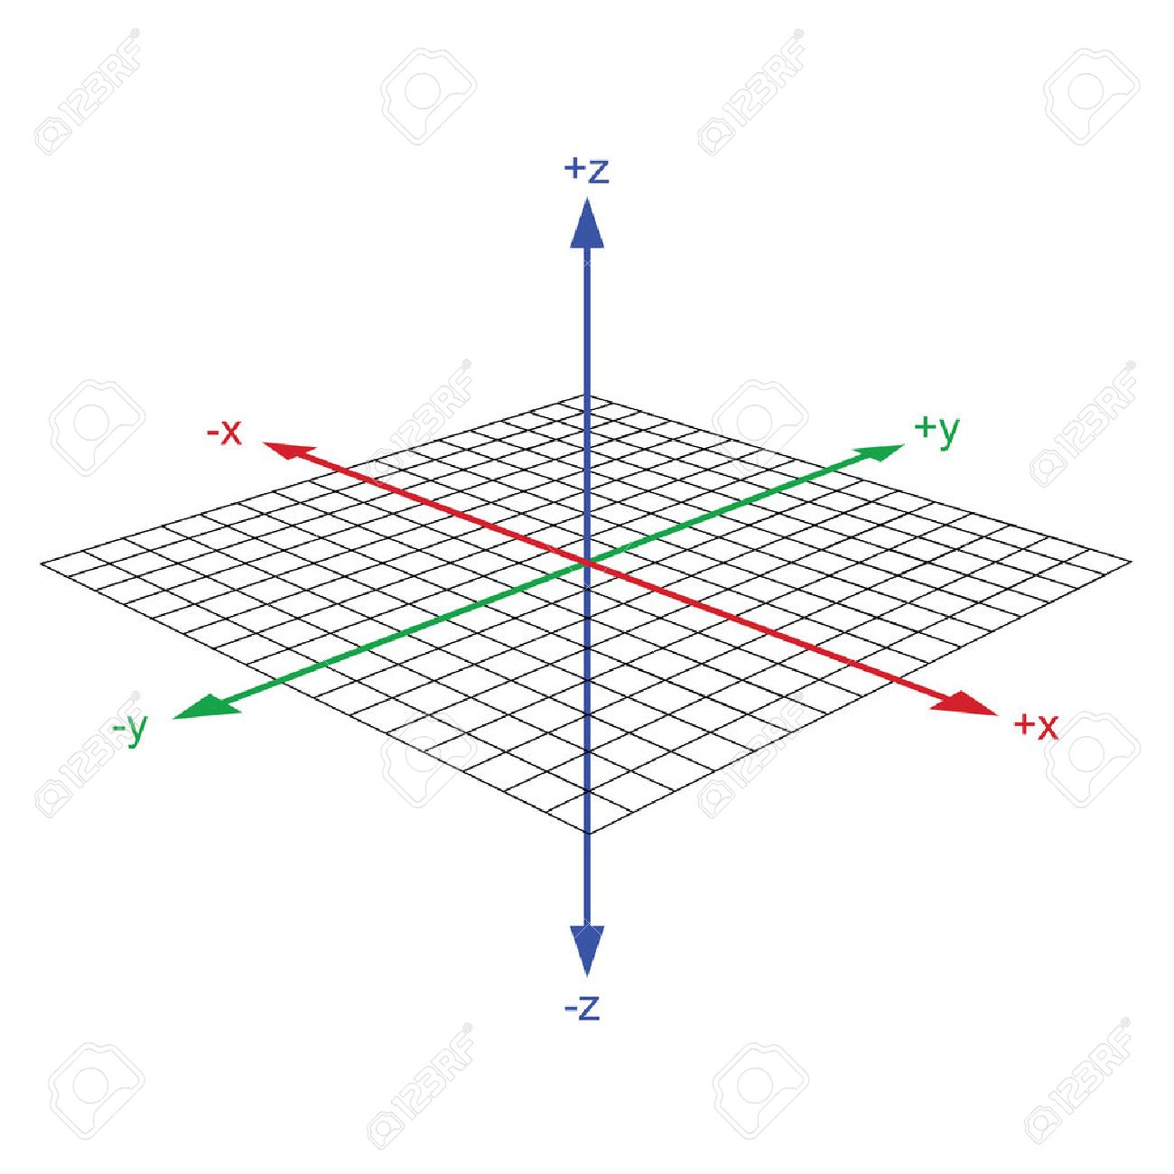
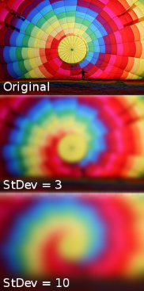
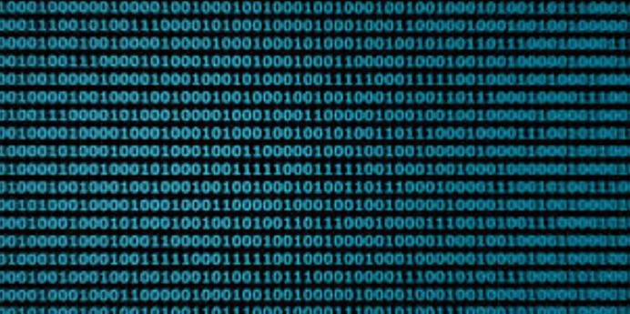




M
A
I
N
D
E
V
I
C
E
Color conversion
[영상처리 라이브러리]
Get Image
Removal
Background
conversion Image
Find Dog Object
Check Object Coordinate
Image Blurring
[영상처리 라이브러리]
Don’t Find
Dog Object
Change the
Image Coordinate
Camera Tile
Receive the Coordinate
Change The
Tile Machine
Focus On
Dog Image

Slide 2
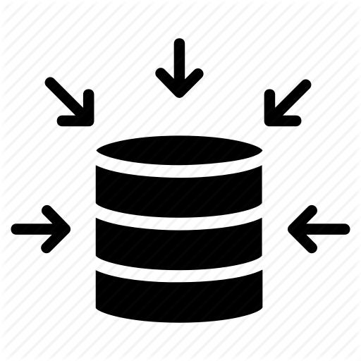
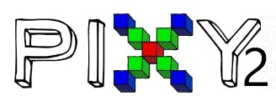
M
A
I
N
D
E
V
I
C
E
Update The
Tile Machine
Focus On
Object Image
Don't find object image
Get Image
Image blocking
[Pixy2 라이브러리]
Storage Image and RGB
Object Detection
Check Object Coordinate
Change the
Object Coordinate
Find Object
Color_connected
[Pixy2 라이브러리]

Slide 3


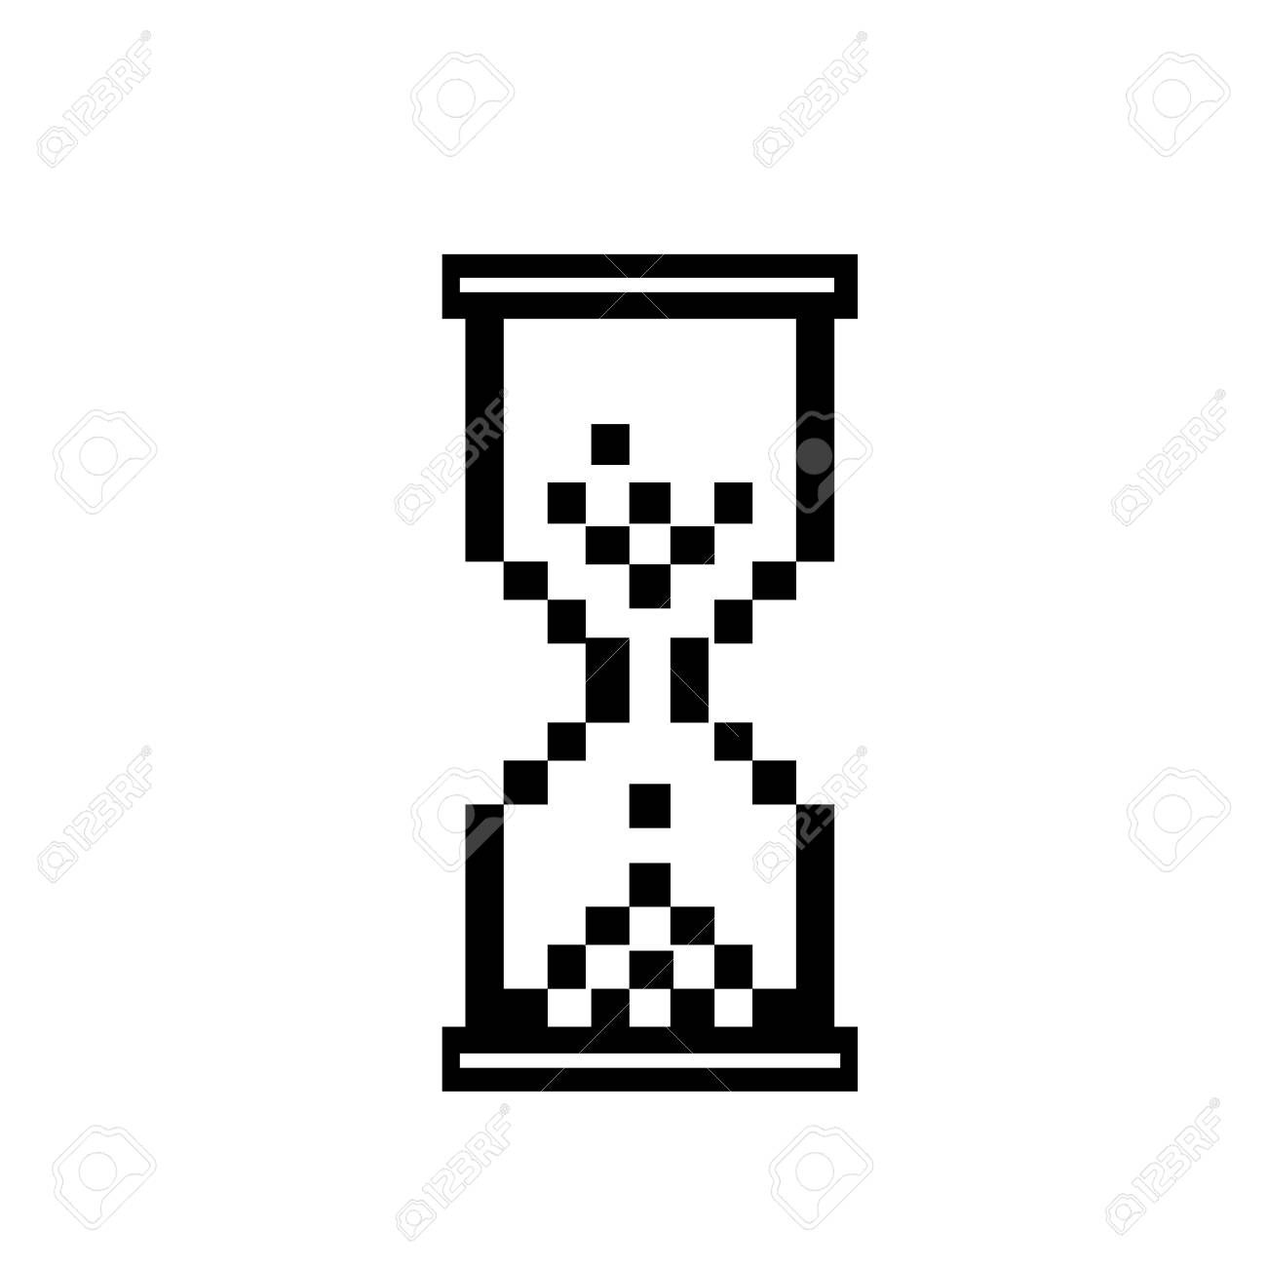
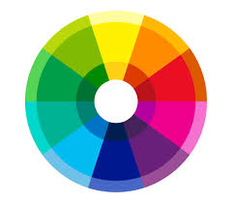



S
U
B
D
E
V
I
C
E
Color conversion
[영상처리 라이브러리]
Get Image
Identify
Day
conversion Image
Set Range Image
conversion Image
Image Blurring
[영상처리 라이브러리]
Discordance Day
Data Reset
Pixel Color
Comparison
Color comparison matching
Examination overlap
Decision Dog
Bowel Movement
Frame
Division
None Overlap
Overlap Data

Slide 4

S
U
B
D
E
V
I
C
E
Color conversion
[색깔 변환 단계 ]
Image Blurring
[잡음제거 단계]
conversion Image
Frame Division
[감시 구역 설정]
Get Image
Identify
Day
Discordance Day
Data Reset
Average Color decision Histogram
Pixel Color
Comparison
Color comparison matching
Examination overlap
Decision Dog
Bowel Movement
Another
White
None Overlap
Overlap Data

